Slide 1
StackOverflow: Network analysis and
Tag recommendation
Tag recommendations in context of social question and answer site StackOverflow.
By building a graph of tag-tag relationships, we analyze the activities and interests of StackOverflow users.
Aim to analyze the evolution of the network over time, compared to static approaches, and to incorporate methods of link prediction in network analysis
Submitted by: Ananya Sharma-2023EET2186
Shaik Kareem -2023EET2194

Slide 2
About Stack Overflow:
Largest Community: Question Answering communities
relies on metadata called tags, which aid in indexing, categorizing, and searching for content and are explicitly requested by users when posting a question.
Labeling questions with tags is mandatory
Analyzing the tags to gain insights into the user community
reflects shared interests among community members.
represent tags and their occurrences as a graph. The graph's nodes represent tags, and common edge represents if there is at least one question where they appear together.
The edges are weighted based on the number of times the two tags connected by the edge appear in the same question.
We will compare this tag-tag network with some standard models:
Barabási-Albert, Erdös–Rényi, Watts–Strogatz, and Configuration Model
identify the areas where users ask the most questions, leveraging the learning aspect of the service

Slide 3
Related work Tag recommendation systems
https://www.researchgate.net/profile/Thomas-Roth-Berghofer/publication/225070583_ConTag_A_Semantic_Tag_Recommendation_System/links/0912f50c5cc6d16410000000/ConTag-A-Semantic-Tag-Recommendation-System.pdf
https://www.kde.cs.uni-kassel.de/wp-content/uploads/ws/dc09/papers/proceedings.pdf#page=285
https://dl.acm.org/doi/abs/10.1145/1363686.1364171
https://www.sciencedirect.com/science/article/pii/S0164121214002064

Slide 4
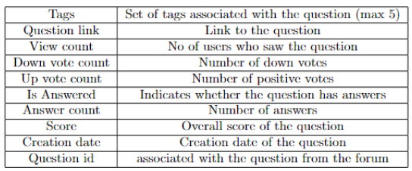
Data Collection and Analysis
The network data set was taken from a public networks data set provided by Stanford.
Dataset:https://snap.stanford.edu/data/sx-stackoverflow.html
Dataset Statistics :# of questions,# of tags, # of unique tags, Average # of tags per question.(after grouping the tags)
The constructed network, referred to as RW (Real World Network), was compared with four other synthetic models created using default algorithms.
Description of dataset

Slide 5
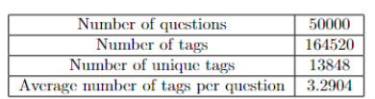
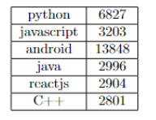
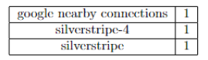
Tagging
Due to the increasing specificity of tags entered by users, some tags had a frequency exceeding 2500 occurrences while others, highly specific, had a frequency of 1. About 98% of the tags appear fewer than 100 times, compared to the top 19 most frequent tags that appear more than 1000 times. These results suggest a highly skewed distribution, with relatively few frequent tags dominating the dataset.
Statistics of Dataset
Frequency of less occurring tags
Frequency of dominating tags

Slide 6
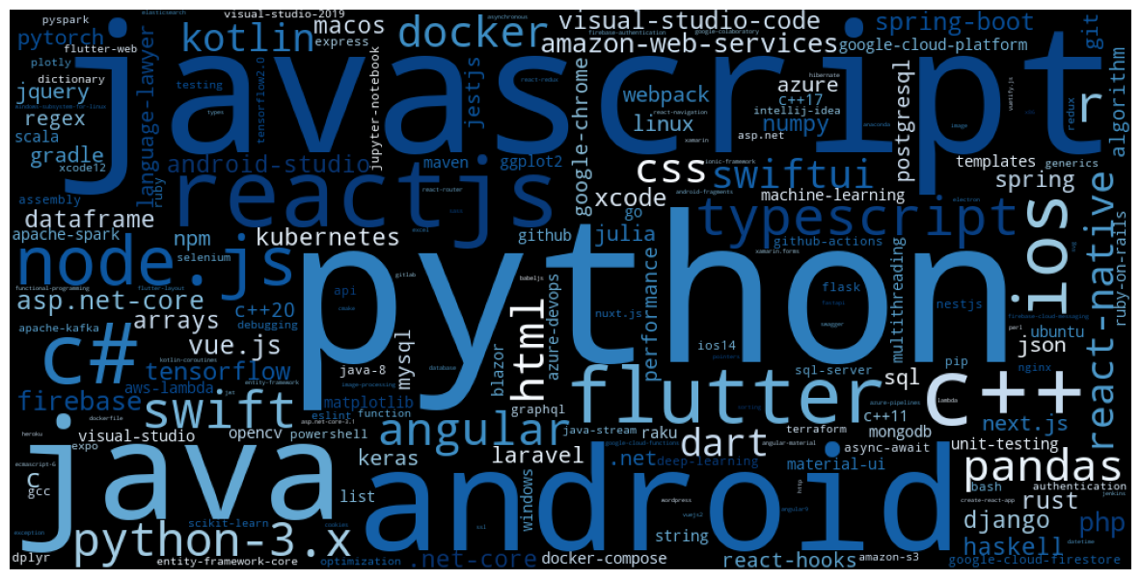
Tagging
Frequency of less occurring tags
Frequency of dominating tags
Tag Cloud

Slide 7
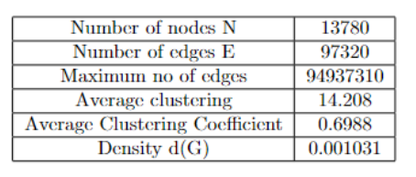
Grouping tags
Tags were grouped into the following 7 macro-areas based on their meaning in the field of computer science:
Programming Languages:containing tags related to programming languages and their libraries.
Database: including tags related to databases.
Development Tools: encompassing development environments and cloud-related tags.
Web & Application Servers:tags referring to network protocols, security, and web development.
Operating Systems: related to tags tied to operating systems, computer peripherals, components, and file extensions.
Data Structures & Functions: a collection of tags related to data structures and functions.
The resulting network, is a bi-directional network with 13780 nodes and 97892 edges.

Slide 8
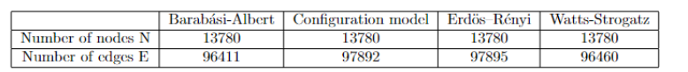
Network Characterization
The constructed network i.e. Real World Network was compared with four other synthetic models created using predefined algorithms.
Barabási-Albert (BA) of n nodes is grown by attaching new nodes each with m=7 edges that are preferentially attached to existing nodes with a high degree, where 1 <= m < n.
Configuration model (CM) constructed following the degree distribution of the real-world network.
Erdös–Rényi (ER) chooses each of the possible edges with probability p.
Watts-Strogatz (WS) where k = Each node is connected to k nearest neighbors in a ring topology and p = The probability of rewiring each edge. here, k = 14 and p = 0.1.

Slide 9
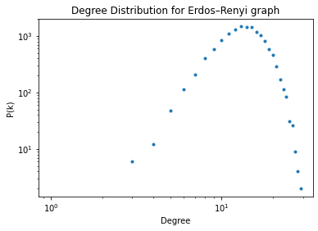
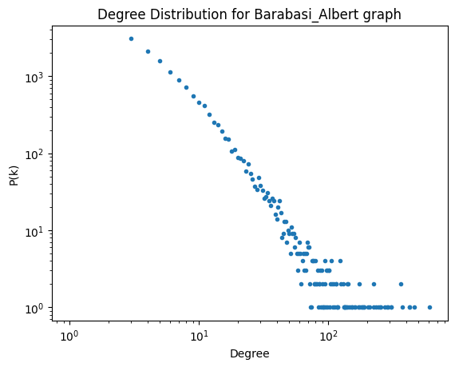
Degree Distribution Analysis

Slide 10
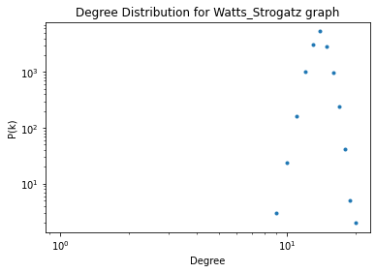
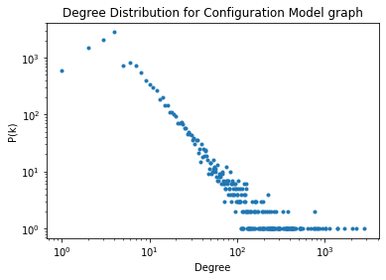
Degree Distribution Analysis

Slide 11
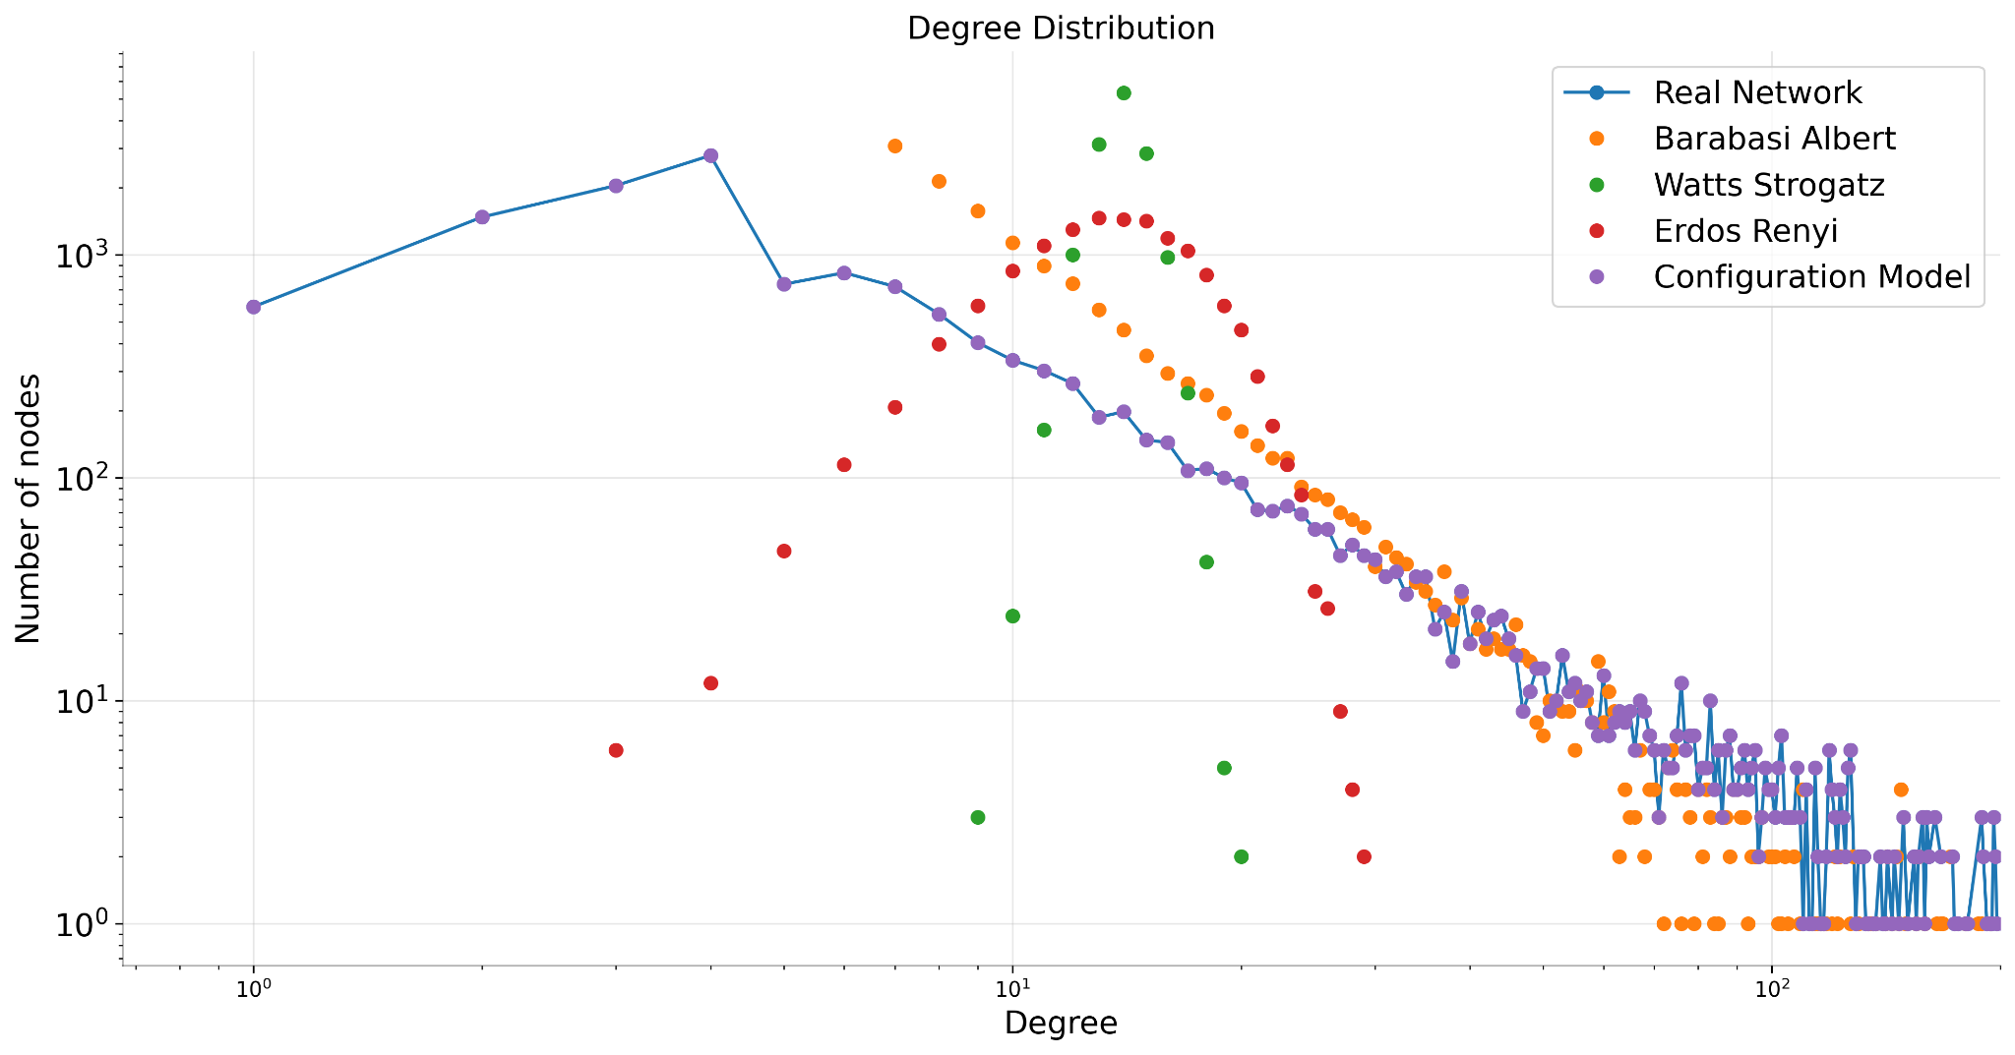
Degree Distribution Analysis
The constructed real-world network is similar to the Configuration Model, as expected. Configuration Model is a random network model that relies entirely on maintaining the same degree as the Real world network. The network is also similar to the Barabási-Albert
model while appearing very different from the ER and WS networks. The network's distribution follows a power-law distribution, as there is an inversely proportional relationship between the number of nodes and their degree.

Slide 12
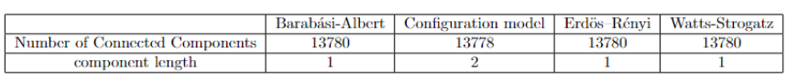
Connected Component Analysis
The analyzed network is composed of a total of 32 connected components, among which a giant component emerged consisting of 13,699 nodes (99% of the entire network), while each other component included at most 4 nodes.
The synthetic models obtained a single connected component, except for the Configuration Model, for which 2 connected components were discovered, one of which was a giant component composed of 13,778 nodes.
Synthetic Networks

Slide 13
Path Analysis
Our network exhibited diameter values similar to synthetic networks (the highest, equal to 8, was observed in the analysis of the Watts-Strogatz network). However, in terms of the average shortest path, it had a value lower than that of the other networks and lower than ln(N) = 9.53.
Since a Scale-Free network is resilient to random node removals but vulnerable if these nodes are hubs for the network, specific node removals of sets were carried out. In particular, groups of 10 nodes with higher Degree Centrality were removed in a test consisting of 9 iterations, evaluating in each the number of connected components, the diameter, and the average shortest path of the Giant Component.

Slide 14
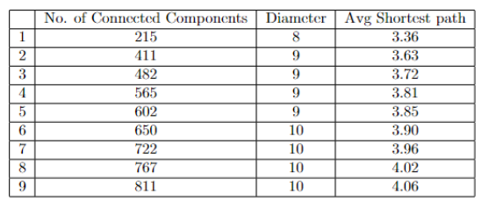
Path Analysis
The removal of hubs will fragment the network into numerous connected components and increases the average path length between two nodes in the Giant Component; a behavior expected in Scale-Free networks.
Hub Removal results

Slide 15
Clustering Coefficient- Density Analysis
The global clustering coefficient of the graph is 0.699, a value higher than those obtained in synthetic networks. As expected, the average clustering coefficient of the ER network is equal to the probability p, with an order of magnitude significantly lower than the value for the real network.
This demonstrates that the random model not only fails to capture the degree distribution of the real network but also the clustering coefficient. Additionally, by observing the ratio between the local clustering coefficient and the node degree, it was highlighted that nodes with a higher degree had a very low clustering coefficient, while nodes with lower degrees tended to have higher clustering coefficient values.

Slide 16
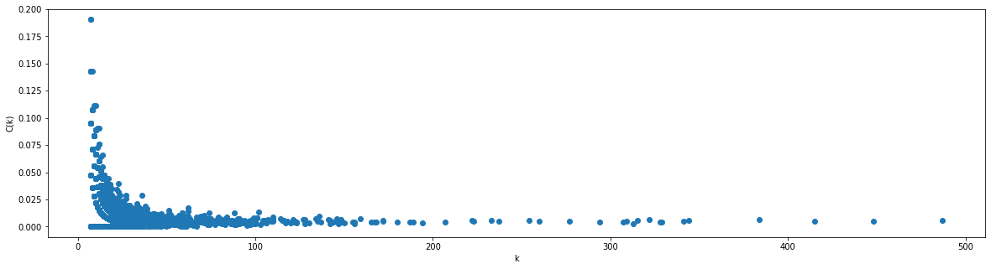
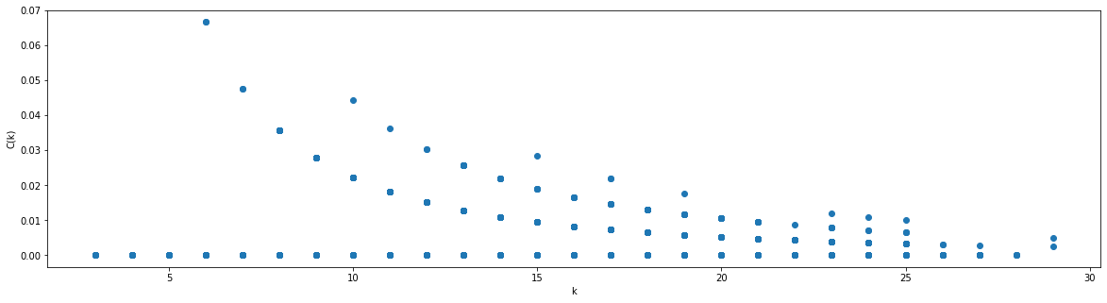
Clustering Coefficient- Density Analysis
BA Model
ER Model

Slide 17
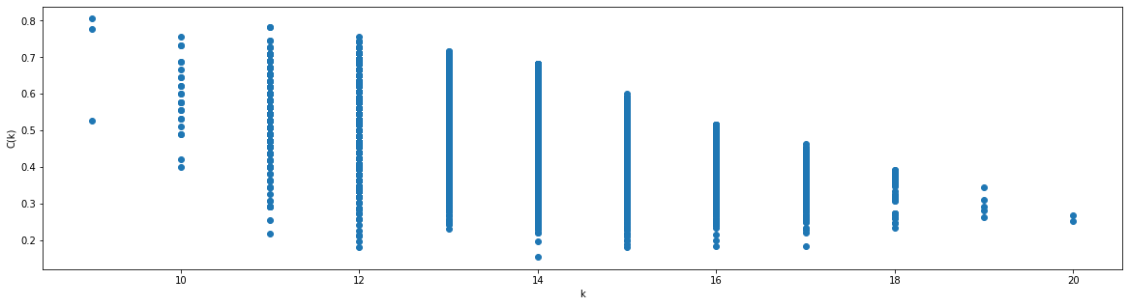
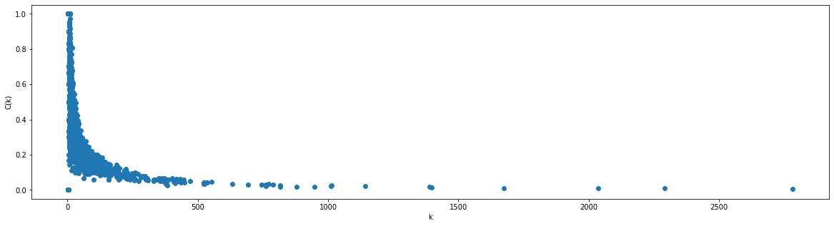
Clustering Coefficient- Density Analysis
WS Model
RW Model

Slide 18
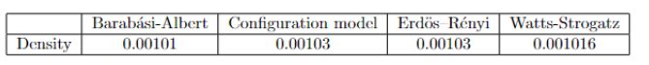
Density Analysis
The density of synthetic networks turned out to be very similar to the density of the StackOverflow network. The very low-density value (close to 0.00103) for all networks is justified by the presence of a much lower number of edges than the maximum possible number (N(N-1)/2), which is close to 94 million.
Relationship between lcc and the node degree, is highlighted in figure that nodes with a higher degree had a very low clustering coefficient, while nodes with lower degrees tended to have clustering coefficient values throughout the entire range

Slide 19
Centrality analysis
The network was analyzed using methods based on different centrality definitions:degree-based, connectivity-based (Eigenvector, PageRank), and geometric-based (closeness, harmonic, betweenness) for the top 15 nodes.
Closeness and Harmonic methods, tags such as visual-studio-code, amazon-web-services, and macos emerged as central, which were not present in the top 15 of the other methods. These two methods reported centrality values that were almost constant, indicating how these centrality definitions are less interesting for the analyzed network.
In most all methods identified python, javascript, and java as the most central nodes.
A substantial difference was found with the Eigenvector method, which identified javascript as the most central node and subsequently three tags semantically related to the language: reactjs, typescript, and node.js.
The Eigenvector Centrality measures the reputation of a node and the recognition it receives from other nodes. In this context, nodes like reactjs, typescript, and node.js provide greater recognition to javascript (compared to python) because they are languages/frameworks based on the javascript language.

Slide 20
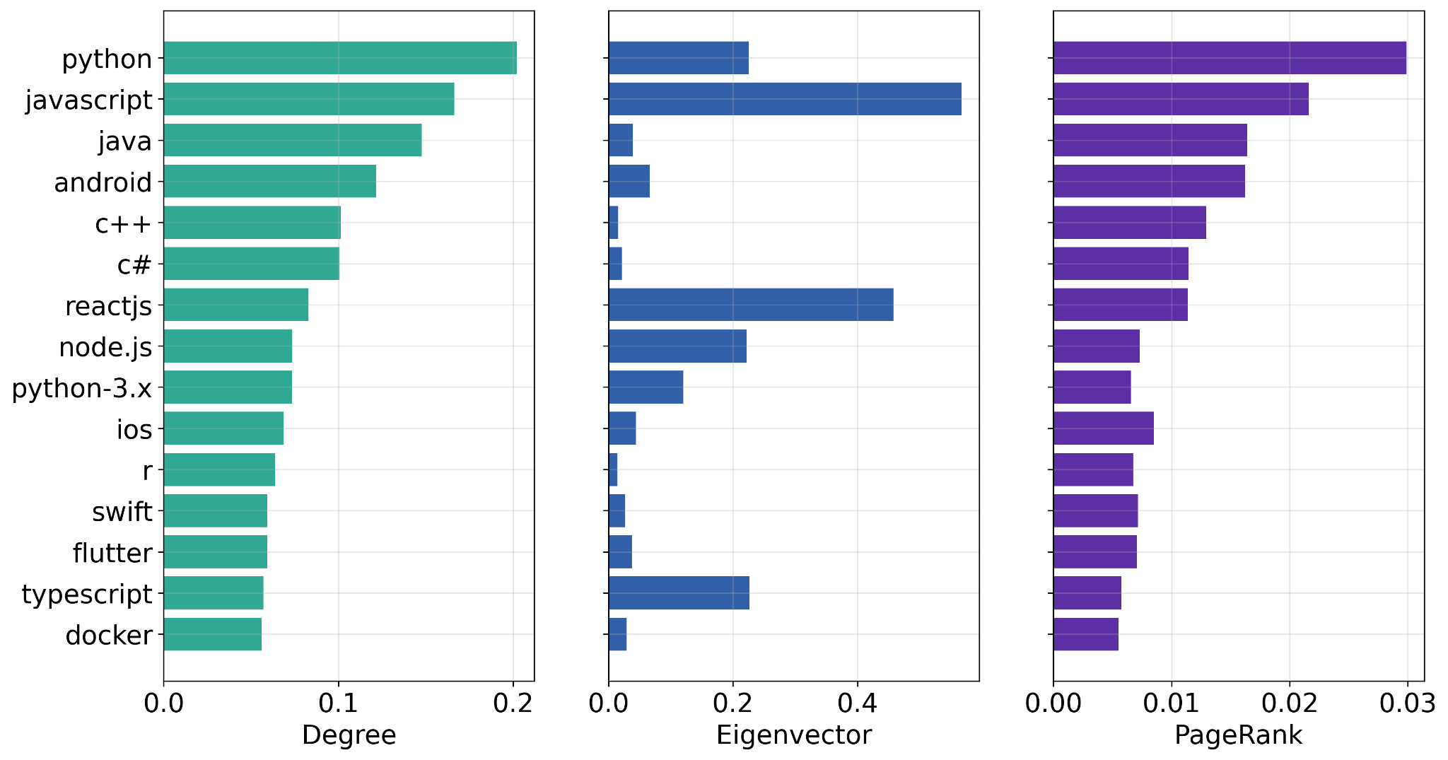
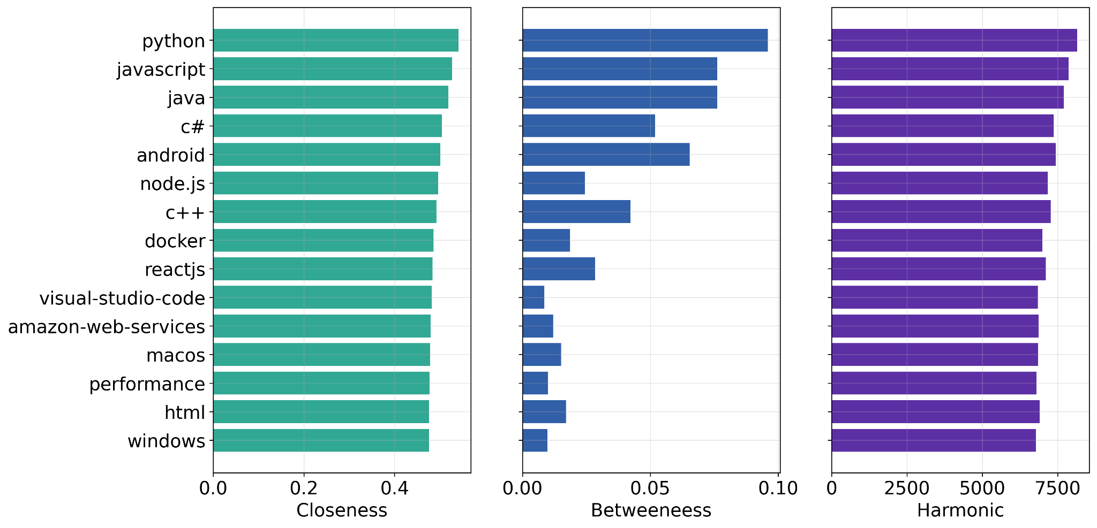
Centrality analysis

Slide 21
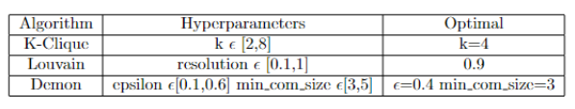
Static Community Discovery
Identify hidden communities within the network using community detection algorithms
K-Clique, Label Propagation, Louvain, and Demon.
For computational reasons, the K-Clique algorithm was executed on a random sample of 8,500 nodes from the original network. Where possible, an optimization phase of hyperparameters was conducted through random search (an optimization strategy provided by cdlib), with the aim of maximizing Modularity.
While Louvain and Label Propagation identify crisp communities where each node belongs to at most one community.
Demon and K-Clique identify overlapping communities, allowing each node to belong to more than one community.

Slide 22
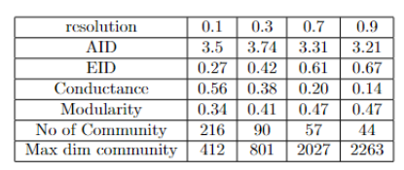
Static Community Discovery
The optimal hyperparameters were further evaluated to maximize Average Internal Degree and Internal Edge Density while minimizing Conductance.
For the Louvain algorithm, the table shows #of communities, size of largest community and metric results for various resolutions. the choice of 0.9 as the optimal value for the resolution parameter is justified by the number of communities found, considering the values of AID, EID, Conductance, and Modularity, which are overall better compared to other parameter values.
Louvain Results

Slide 23
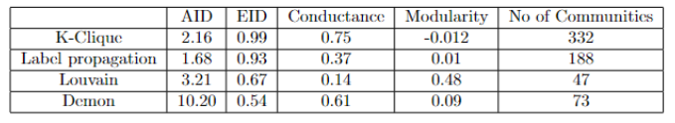
Static Community Discovery
The K-Clique algorithm achieved the lowest modularity value, although it's not directly comparable to the other models due to simplifications made before its execution and covering only 78% of the total nodes.
On the other hand, the Demon model, an algorithm with overlapping communities like K-Clique, covered 94% of the nodes.

Slide 24
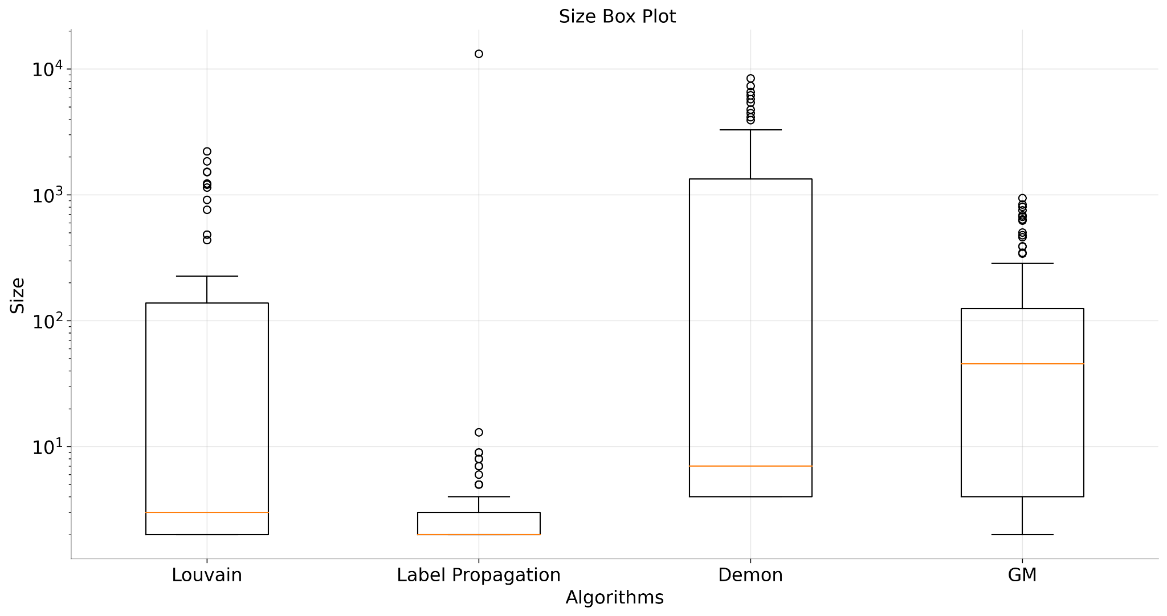
Static Community Discovery
The boxplot of the distribution of community sizes produced by the algorithms.
Label Propagation exhibited one large community (comprising 96% of the nodes) and many small communities, resulting in an unbalanced outcome quite different from the other algorithms.
The Demon algorithm produced more large-sized communities compared to Louvain.

Slide 25
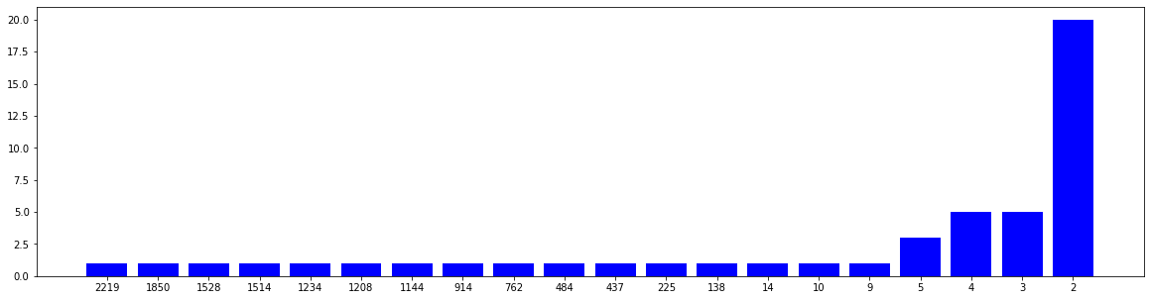
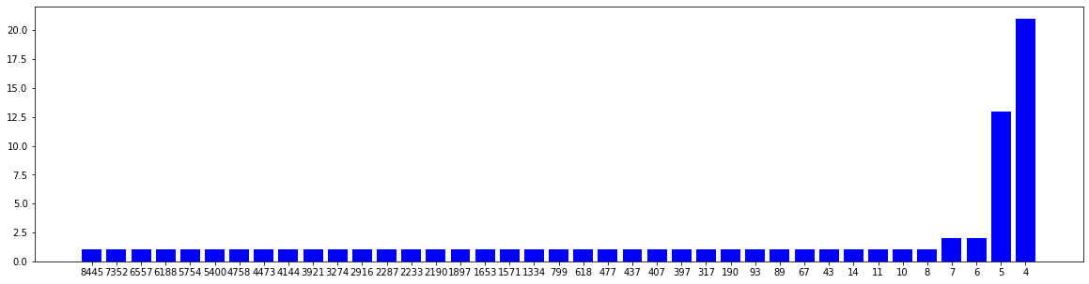
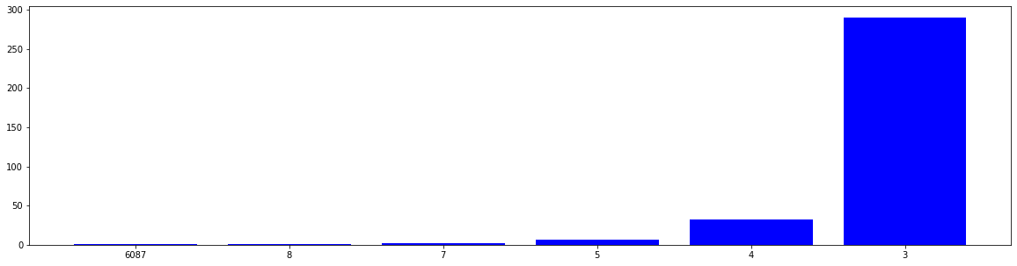
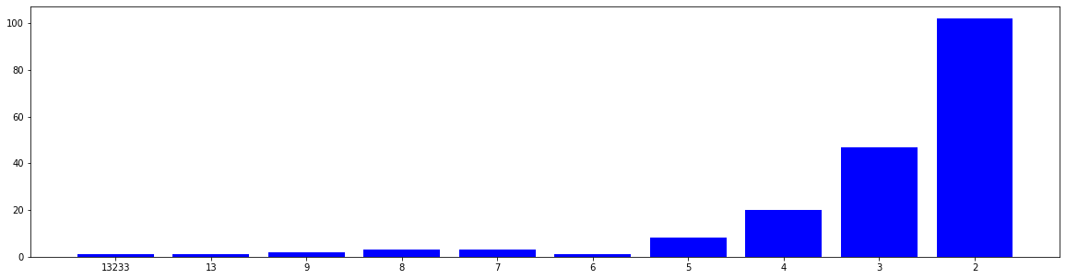
Static Community Discovery
Louvain
Demon
C. K-Clique
Label propagation
Cardinality of Communities

Slide 26
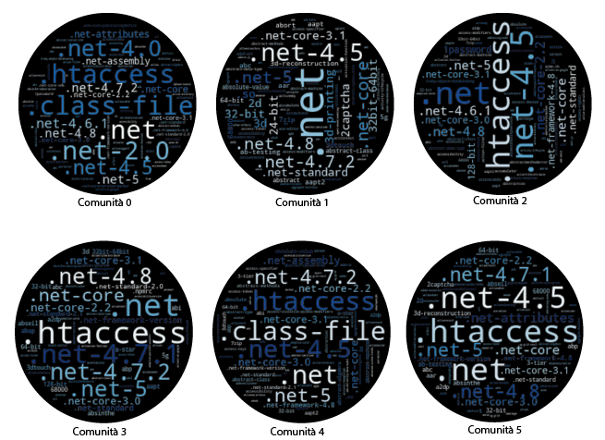
Static Community Discovery
The Demon algorithm has produced overlaps between communities, which displays WordClouds of some communities identified by the algorithm. We observed an example of the overlaps, particularly among the first 6 communities, all semantically related to tags concerning .NET programming.
Community 0
Community 1
Community 2
Community 3
Community 4
Community 5

Slide 27
Static Community Discovery
The best results, considering the metrics and the number of partitions, were obtained by the Louvain algorithm. Although the number of communities obtained by Louvain was close to that of the Demon algorithm, Louvain had the absolute best values for Conductance and Modularity. Louvain achieved not only fewer large partitions than Demon and smaller-sized partitions (given the non-overlapping characteristics of the model) but also semantically more meaningful partitions.
Word Clouds of four communities obtained by the Louvain model are shown, where semantic divisions between the communities are noticeable:
Community 0 - frontend development, with terms such as react, javascript, angular, and css.
Community 1 - development in Python and Julia, with terms associated with these languages, including frameworks and libraries such as Django, Flask, and Matplotlib.
Community 3 - version control, with terms related to debuggers, web services, and GitHub.
Community 12- development in Ruby, with frameworks and keywords linked to the language, such as bundle and rubygems.

Slide 28
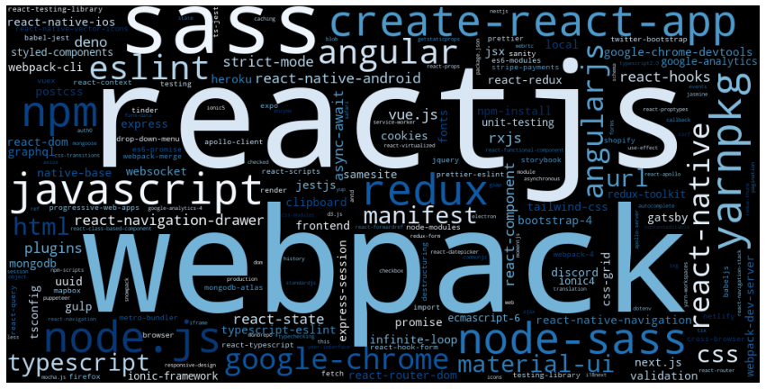
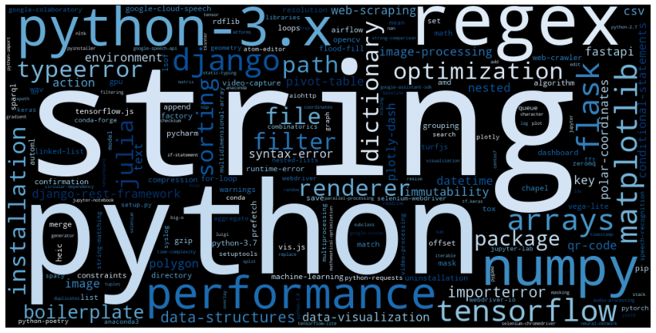
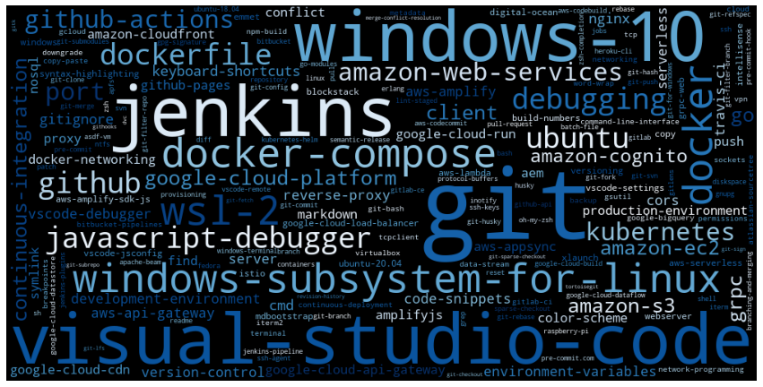
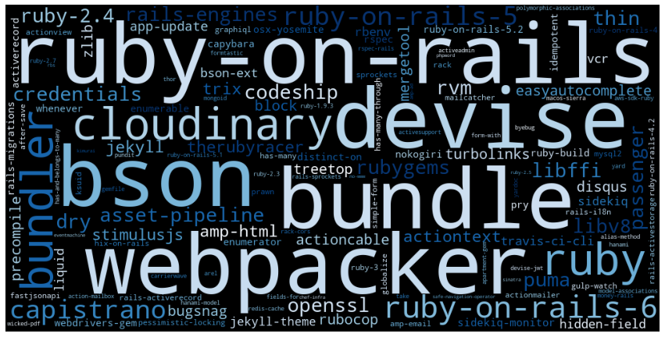
Static Community Discovery

Slide 29
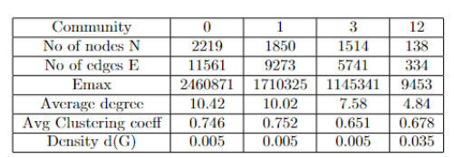
Static Community Discovery
It's evident that the number of nodes and edges tends to decrease from a community with a low index (e.g., Community 0) to a community with a high index (e.g., Community 12), leading to a decrease in related parameters.. This demonstrates that the Louvain algorithm identifies communities with increasingly smaller and denser structures rather than communities with an even distribution of nodes.

Slide 30
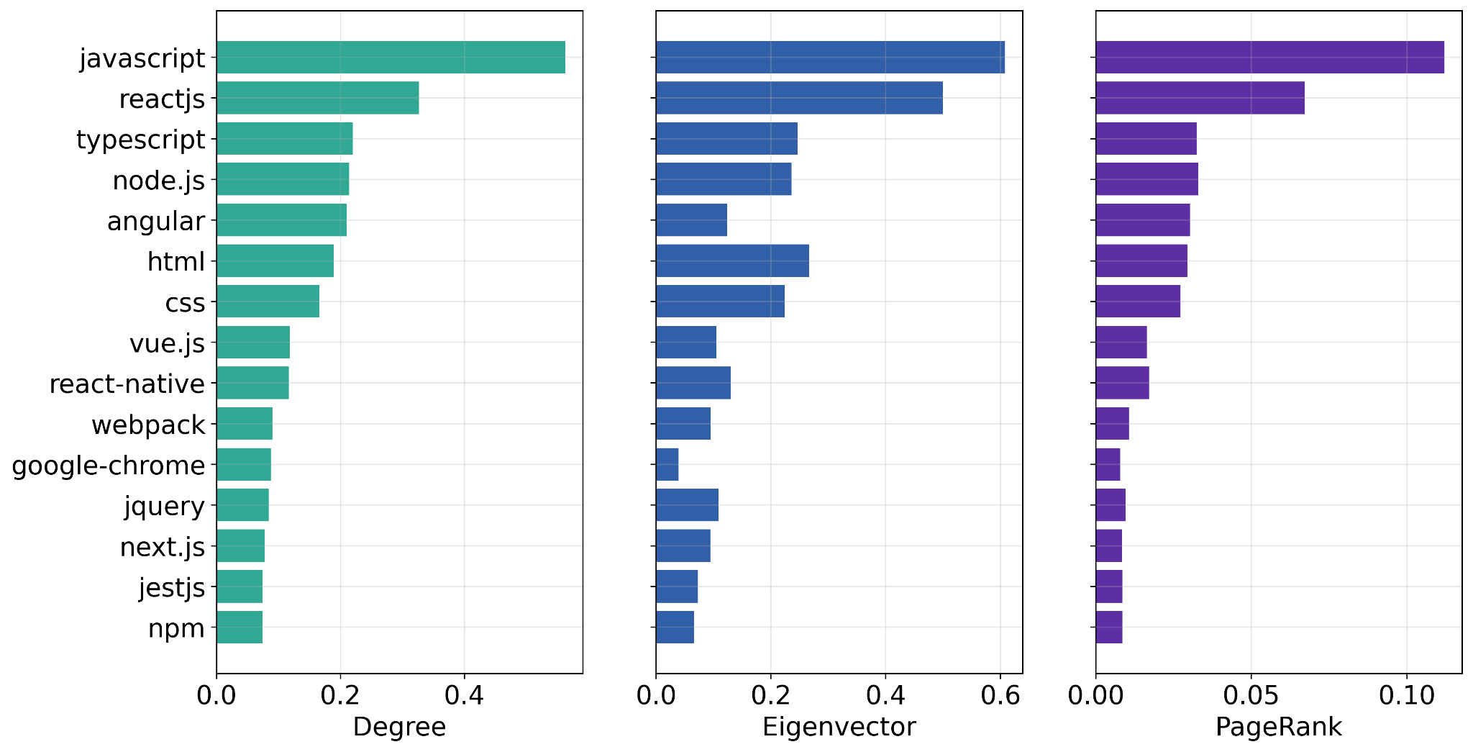
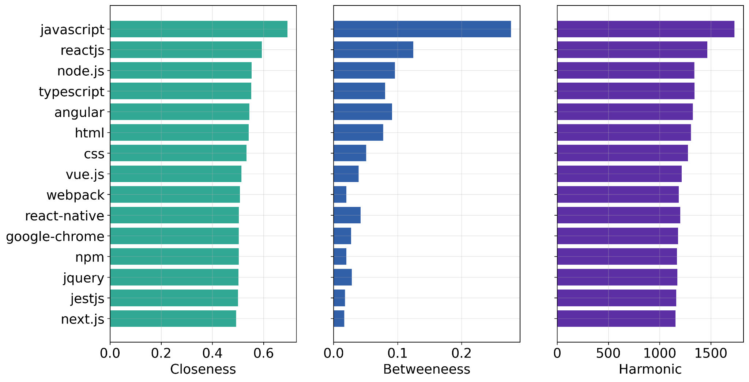
Static Community Discovery
The same centrality analyses were conducted. For each community, observing the most central nodes with various measures. We observed no substantial differences in terms of central tags were found, except for their order.
Community 0, the most central nodes were found to be javascript, reactjs, nodejs, html, while for Community 1 , the central nodes were python, pandas, tensorflow, dataframe, julia.

Slide 31
Dynamic Community Discovery
Dynamic analysis provides insights into how user interests and discussions evolve over time within the Stack Overflow community.
identify patterns of community and the changing dynamics of user interests and discussions over time
Temporal Analysis
number of questions collected each month. It reflect changes in user interactions and engagement patterns over the year.
Aggregation of Tag Scores:
To monitor trends in the popularity of different topics. Tag scores are aggregated monthly.
To observe trends in the popularity of different software tools and technologies, scores for tags were aggregated monthly for three tag categories: Programming Languages, Web Frameworks, and Operating Systems,.. Through these scores, it's possible to monitor which tags received more positive attention from the Stack Overflow community throughout the year.

Slide 32
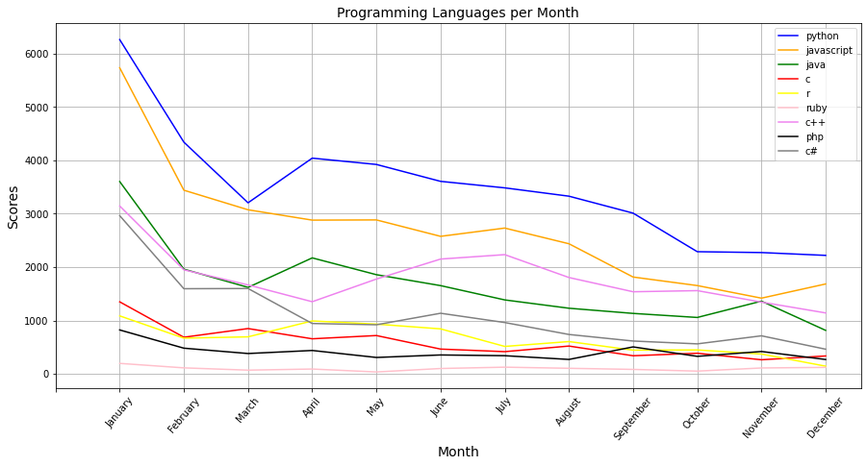
Dynamic Community Discovery
Python and Javascript remain the top two programming languages

Slide 33
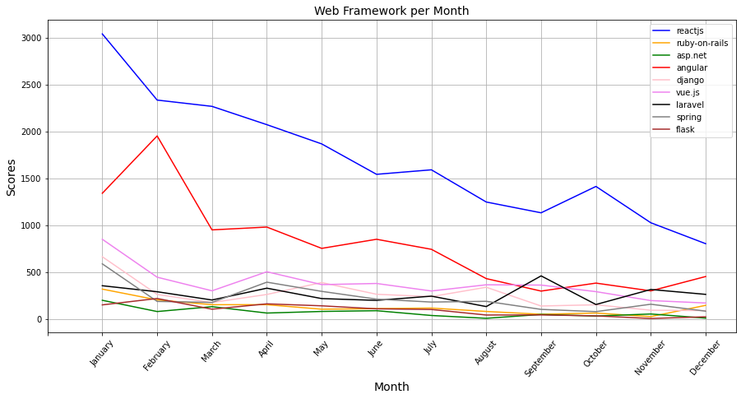
Dynamic Community Discovery
Trends in web frameworks indicate greater community interest in Reactjs and Angular, possibly reflecting their widespread adoption by most web-oriented companies in the past year.

Slide 34
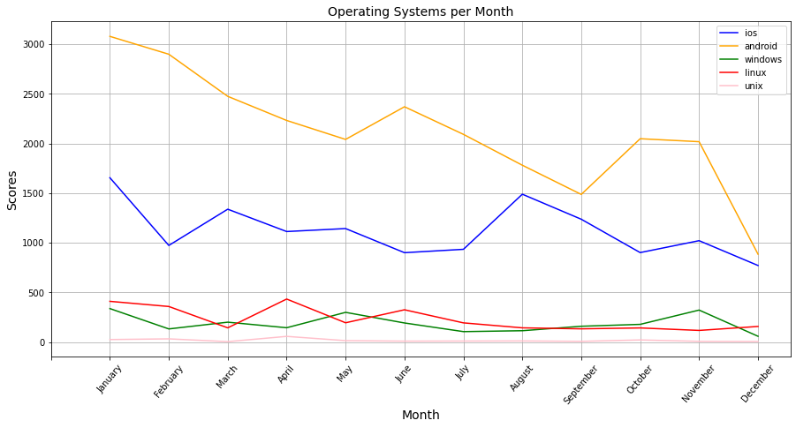
Dynamic Community Discovery
Tags related to operating systems, where Android is the most dominant, followed by iOS. This trend indicates a bias in the community towards discussions about programming for mobile platforms.

Slide 35
Dynamic Community Discovery
Before applying dynamic community discovery, a static community discovery algorithm is chosen.( say Louvain algorithm because it identifies a significantly lower number of communities than the others, with a very stable distribution throughout the year
Louvain algorithm is applied to each monthly snapshot to obtain a set of communities for each month.
A life cycle graph is constructed using the Jaccard similarity to represent the evolution of communities over the 12 months.
A methodology of Instant Optimal community discovery was implemented, considering the intuitive division into monthly snapshots of temporal traces and utilizing the Temporal Clustering structure.

Slide 36
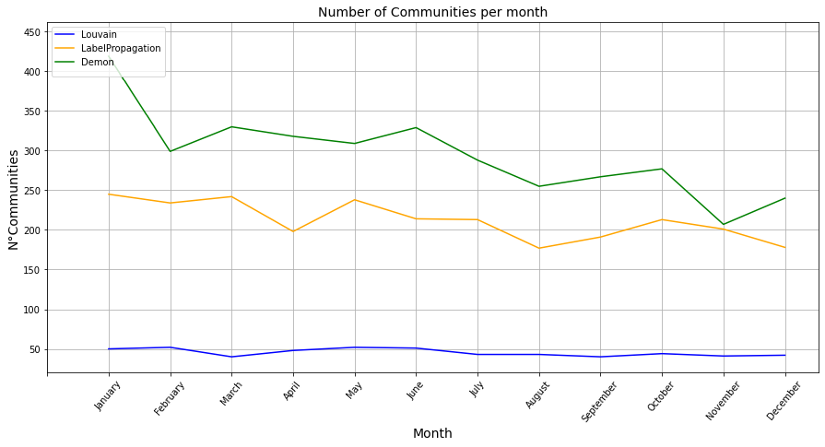
Dynamic Community Discovery
Almost every month, the algorithm identifies a small group of communities significantly larger than the others, with many residual communities formed by fewer than 20 tags.

Slide 37
Unsupervised Link Prediction
The execution of this task, aiming to predict links between nodes in the network, was carried out using two subgraphs of the network due to computational constraints.
The two subgraphs, G1 and G2, were obtained by selecting nodes with degrees greater than 50 and 30, respectively. This sampling choice was made to retain only the most important nodes, which are more likely to be connected, thus reducing the potential for false positives.
The performance of these link prediction methods was assessed using ROC curves, which can be categorized into three types. ROC curves provide insights into the trade-off between true positive and false positive rates for different prediction thresholds.
Neighborhood-based: These methods calculate a score between two nodes (x and y) based on the neighbors they have in common. Three specific methods from this category were tested: Common Neighbors, Adamic Adar, and Jaccard Index.
Path-based: Path-based methods, including Katz, we consider the number of paths connecting two nodes in the network.
The SimRank method assigns scores based on the similarity of neighbors.

Slide 38
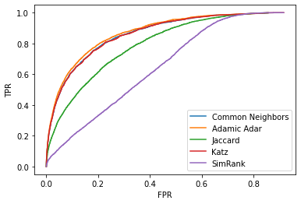
Unsupervised Link Prediction
The subgraph G1 , was obtained by selecting nodes with degrees greater than 50. There are 597 nodes and 18,056 edges.

Slide 39
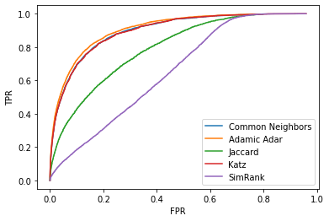
Unsupervised Link Prediction
The subgraphs G2, was obtained by selecting nodes with degrees greater than 30.. In G2, there are 1,057 nodes and 28,301 edges.

Slide 40
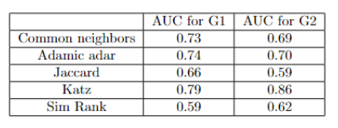
Unsupervised Link Prediction
It can be observed that the predictors based on neighborhood have obtained lower values when transitioning from the G1 sample to the G2 sample. This difference is likely due, by construction, to the characteristic of G2, which has almost half of the nodes with a lower degree compared to the nodes in G1.
The other two methods, based on paths and ranking, obtained higher values for G2 compared to the previous test, particularly Katz.
Overall, good results were obtained, likely due to the characteristics of the network being strongly connected. Further explorations, such as the intersection of the top 100 links predicted by each method, did not yield additional information, except for the presence of nodes with tags related to Python for both the methods applied to G1 and those applied to G2.

Slide 41
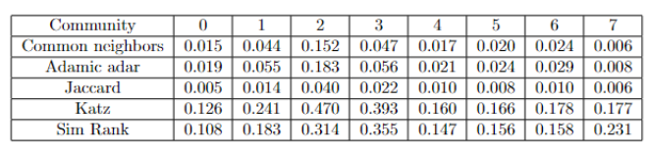
Unsupervised Link Prediction
The same Link Prediction methods were tested on subgraphs obtained from the first 8 communities reported by the Louvain method, considering a random sample of some # of nodes for each community.
Results showed AUC values significantly lower than the previous tests, as visible in these tests, nodes were not randomly sampled but considered based on their degree.
However, even in this case, the Katz method (together with the SimRank method) obtained higher values than the other methods, proving to be the best for the type of data considered.

Slide 42
Influence of a network
. Two mathematical diffusion models,
SI (Susceptible-Infectious) and Profile, are examined
compared with those obtained on synthetic models
The SI model considers that an individual can be in either a Susceptible (S) or Infected (I) state, without the possibility of being in a Removed (R) state.
We analyze the speed of diffusion of information
Profile model, which assumes that the diffusion process is only apparent, giving each node the ability to choose whether or not to adopt a particular behavior based on its interests.

Slide 43
Spreading in Stack Overflow
For the network used, it wasn't possible to consider spreading as the classic epidemic diffusion but rather as the dissemination of information, such as the introduction of a new framework initially associated only with certain tags (in questions posed by developers) and gradually linked to other tags (languages, frameworks, libraries) through the development of the framework itself in terms of portability, integrity, and extensions.
For this reason, the SI model (Susceptible-Infected) was preferred over its extensions SIS and SIR because the states of healing and removal would be meaningless in this analysis.
The model considers two states for an individual: Susceptible (S) or Infected (I), without the possibility of being in the Removed (R) state.
The model was executed using an initial percentage of infected individuals equal to 5% of the population with beta equal to 0.001.

Slide 44
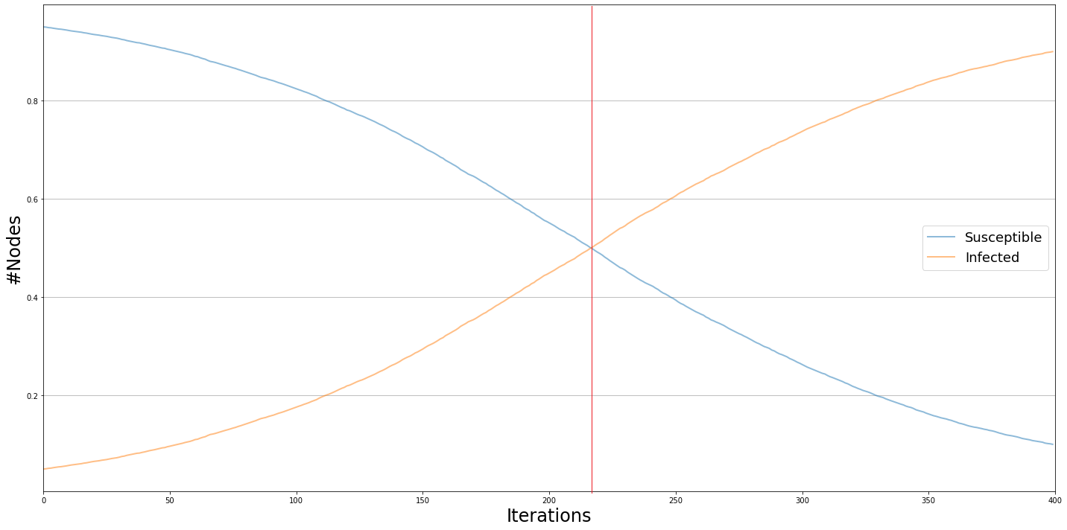
Spreading Dynamics:
It is shown that the spreading speed in a random network of the same size as the Stack Overflow network is lower compared to a Scale-free network. A ratio of healthy to infected individuals of about 50 % is achieved at iteration 224 for the random network, while for the Stack Overflow network, this ratio is reached at iteration 163.
The spreading dynamics for the Barabàsi-Albert network are similar to the expected behavior for the random network (but faster).

Slide 45
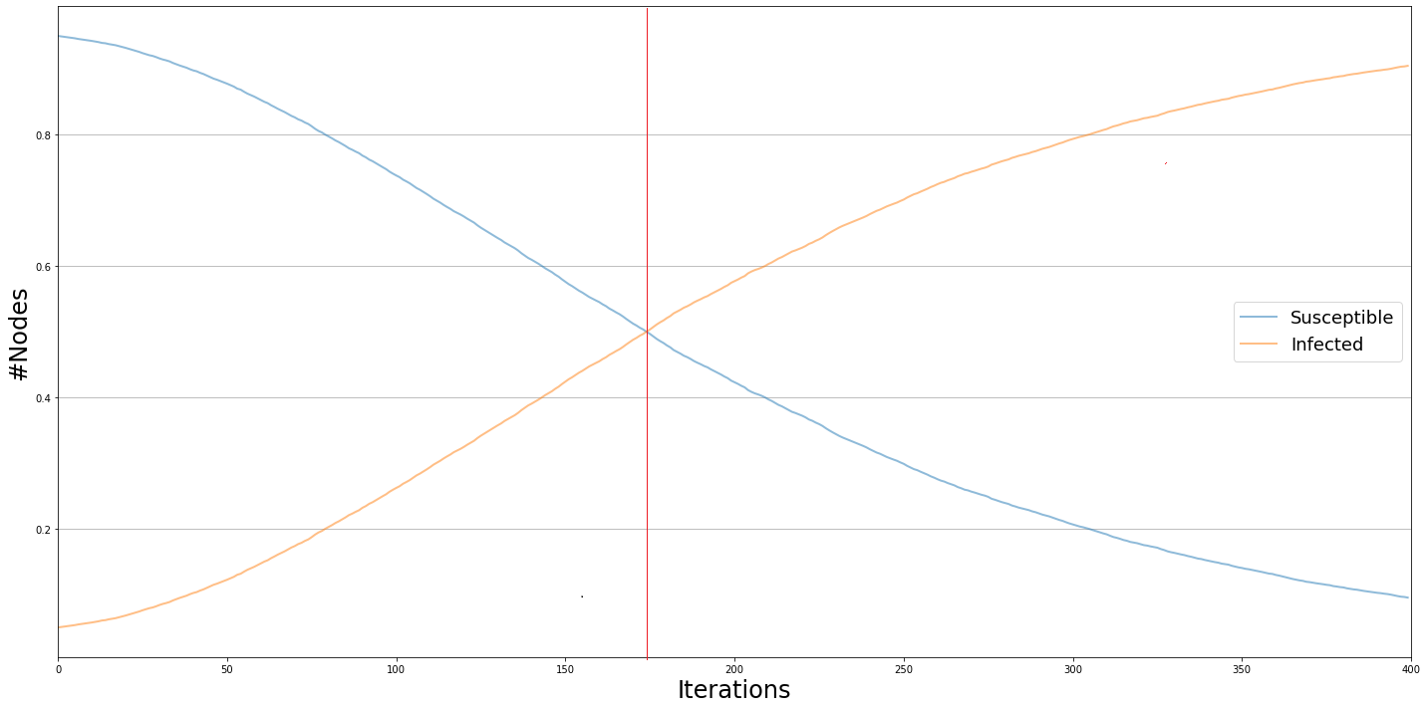
Spreading Dynamics:
information spreads through the BA network more quickly than the ER network but more slowly than the Stack Overflow network, reaching a 50-50 ratio between healthy and infected individuals at iteration 180.

Slide 46
Hubs and Information Spreading:
The presence of hubs significantly influences the speed of information spreading because hubs, having more opportunities to come into contact with an infected individual, are more likely to become infected and infect others.
In the examined network, hubs, represented by major programming languages (such as Python, JavaScript, Java), would likely be among the first to be involved in creating or extending a framework.
demonstrating that the removal of hubs (at the same beta) results in a slower spreading speed
In this case, a parity between the set of healthy and the set of infected individuals is reached at iteration 252, 89 iterations later than the network with hubs.

Slide 47
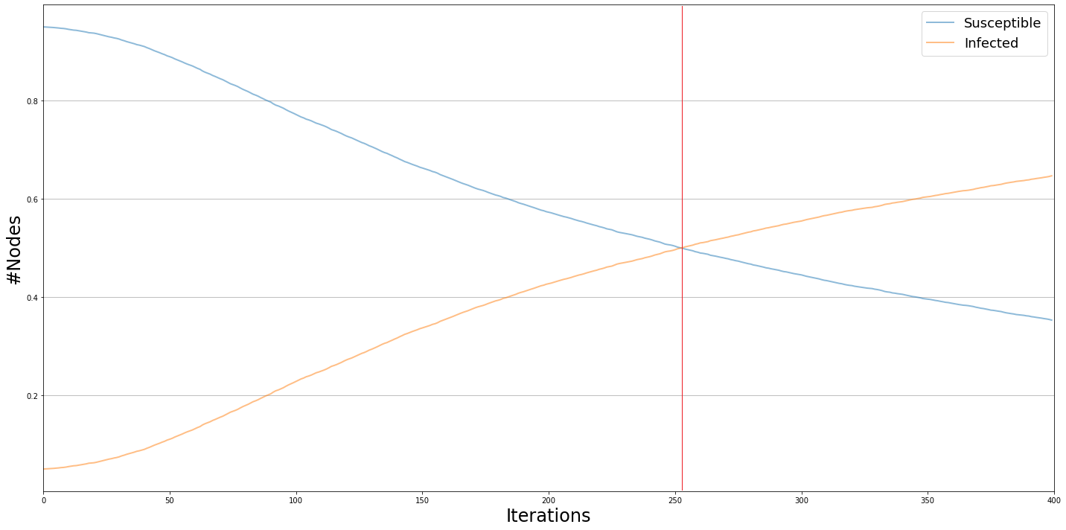
Hubs and Information Spreading:
StackOverflow without hubs

Slide 48
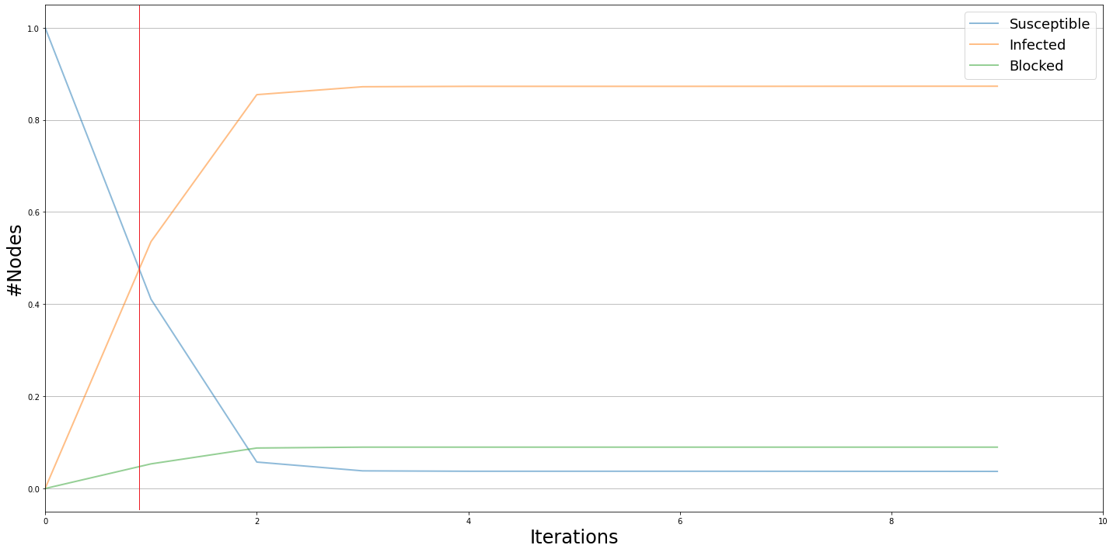
Profile Model Trials:
Profile model assumes that the spreading process is only apparent, giving each node the ability to choose whether to adopt a certain behavior based on their interests. This deviates from the idea of classic epidemic spreading (not suitable for this network). Since the spreading process, in this context, starts from a set of infected nodes that have already adopted a certain behavior (S), four trials were conducted, differing in how this set is chosen:
Selecting the most central nodes :

Slide 49
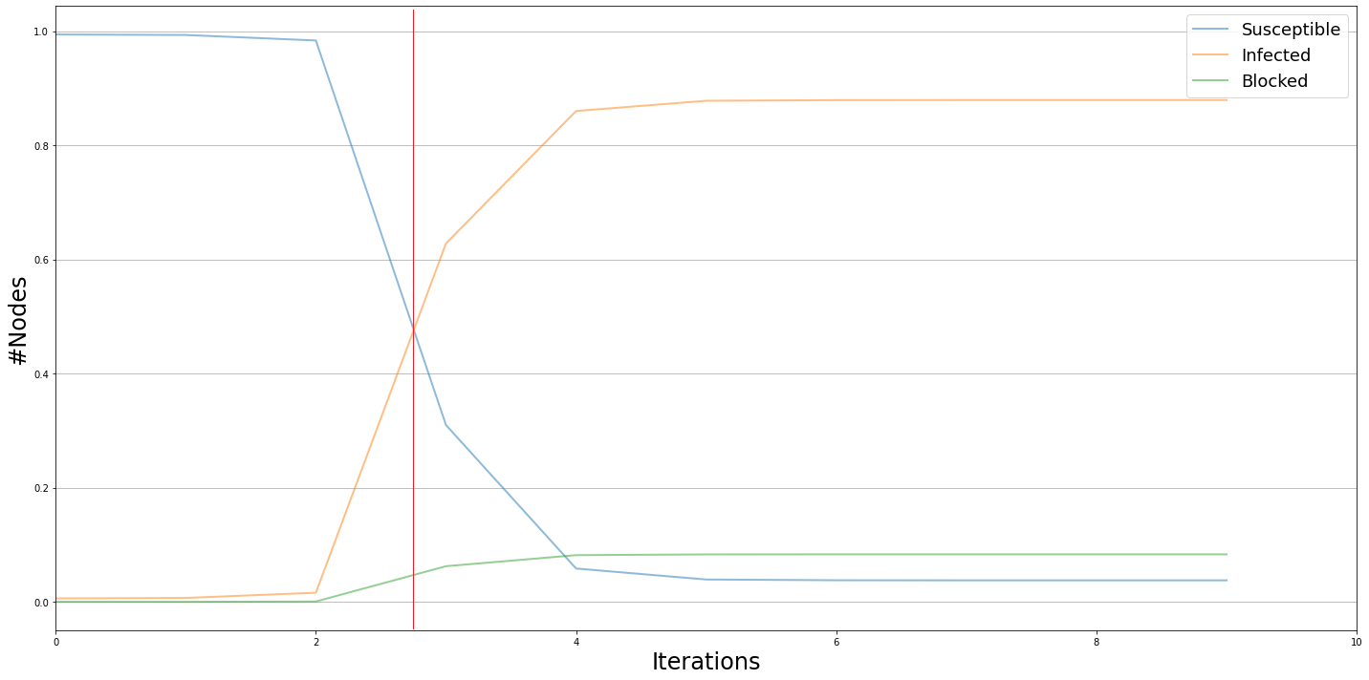
Profile Model Trials:
Figure shows diffusion behaviors for the four trials conducted. The increase in nodes adopting the behavior and the consequent decrease in susceptible nodes are slower when starting from random nodes compared to when the set S is initialized with central nodes
Selecting marginal nodes, i.e., those not belonging to the giant component:

Slide 50


Profile Model Trials:
Selecting the most central node from each community identified by the Louvain algorithm\
Selecting random nodes (choosing an initial fraction of nodes equal to 0.06\% of the sample),

Slide 51
Profile Model Trials:
For each susceptible node near a node in state S, a biased coin is flipped, with the bias set at 10% for each node in this implementation. The node will adopt the behavior if the coin flip is positive. If the adoption is rejected, a node enters the blocked state with a fixed probability of 10%. The adopter rate was set to 0.001, so at each iteration, 0.1% of nodes adopt the behavior.
This configuration of values was chosen because increasing the bias would have slowed down the speed at which nodes would have adopted the behavior, while increasing the adopter rate would have resulted in faster behavior diffusion.

Slide 52
Conclusion and Future Work:
The project successfully achieved its goal of analyzing the interactions between StackOverflow tags, in the tasks of Community Discovery and Link Prediction.
Further analyses could be conducted by considering a temporal window exceeding one year to gain a more comprehensive understanding of tag interactions and the evolving interests of forum users.
Our work provides a foundational study that could potentially contribute to the improvement of the tag autocompletion system during question creation in the future.

